Slide 1
RUNGTA COLLEGE OF DENTAL SCIENCES & RESEARCH
TITLE OF THE TOPIC: MICROBIOLOGY IN ENDODONTICS
DEPARTMENT OF CONSERVATIVE DENTISTRY AND ENDODONTICS

Slide 2
Specific learning Objectives
At the end of this presentation the learner is expected to know
Core areas* H | Domain ** | Category #
Routes of microorganism, Microrganism associated with root canal infection | Cognitive | Must know
Intraradicular infection, extraradicular infection | Psychomotor | Nice to know
Methods of identification of microbes | Affective | Desire to know
*Subtopic of importance
** Cognitive, Psychomotor or Affective
# Must know , Nice to know & Desire to know

Slide 3
TABLE OF CONTENT:
INTRODUCTION
ROUTES OF MICROORGANISM INGRESS
MICROORGANISMS FOUND IN ROOT CANALS ASSOCIATED WITH ENDODONTIC INFECTIONS
INTRARADICULAR INFECTION
EXTRARADICULAR INFECTION
METHODS FOR IDENTIFICATION OF MICROBES

Slide 4
PATHOGENICITY & VIRULENCE FACTORS
PATHOGENICITY:
“the ability of m.org to cause disease”
VIRULENCE:
“ the degree of pathogenicity of a m.org
VIRULENCE FACTORS:
“ microbial products, structural components, or strategies that contribute to pathogenicity”

Slide 5
Bacterial virulence factors comprise structural components and released products.
Bacterial strategies that contribute to pathogenicity include the ability to coagregate and forms biofilms, which confers protection against host defenses and antimicrobial agents.

Slide 6
Some m.org. routinely cause disease in a given host and are called primary pathogens.
Other m.org cause disease only when host defenses are impaired and are called oppertunistic pathogens.

Slide 7
Bacteria that make up the normal microbiota are present as harmless commensals and live in balance with the host.
One of the greatest beneficial effects of human microbiota is probably the tendency to protect the host from exogenous infection.

Slide 8
In certain situations, the balance may be disturbed by a decrease in the normal level of resistance, and then the commensal bacteria are usually the first to take advantage.
Most bacteria involved with endodontic infections are normal inhabitants of the oral microbiota , which becomes opportunistic pathogens causing endogeneous infections.

Slide 9
Bacteria involved with pathogenesis of primary apical periodontitis may have participated in the early stages of pulp inflammation and necrosis, or they may have gained entry into the root canal space any time after pulpal necrosis.
In the former situation, involved bacteria are usually those present in the advanced front of carious lesion and from saliva

Slide 10
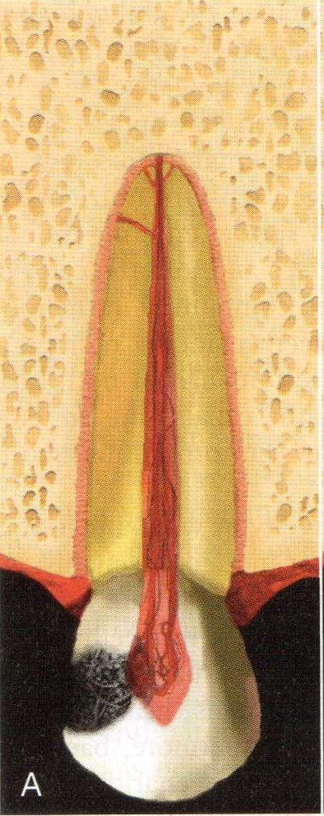
Bacteria in carious lesions form authentic biofilms adhered to dentin.
Bacterial products diffused through dentinal tubules induces pulpal inflamation long before the tissue is exposed.
After pulp exposure, the exposed tissue is in direct contact with bacteria and their products and responds with severe inflammation.

Slide 11
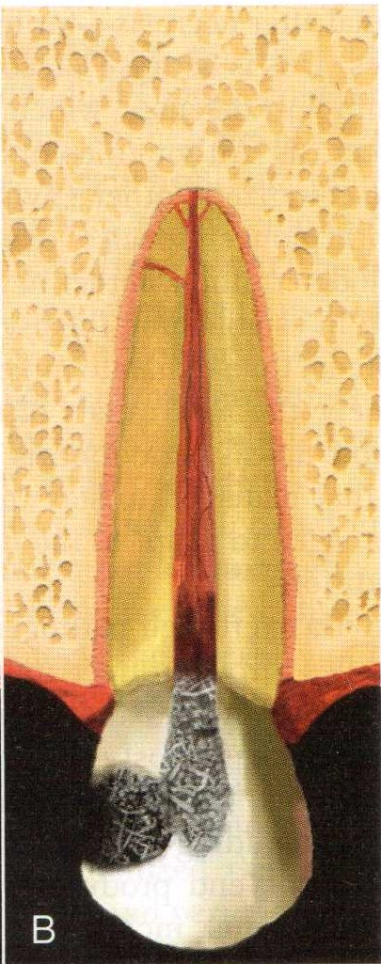
Bacteria in this battlefront have to survive the attack by host defenses and at the same time acquire nutrients to be alive.
In this bacteria-pulp clash, the pulp invariably is defeated and becomes necrotic, so bacteria move forward and colonize the necrotic tissue.

Slide 12
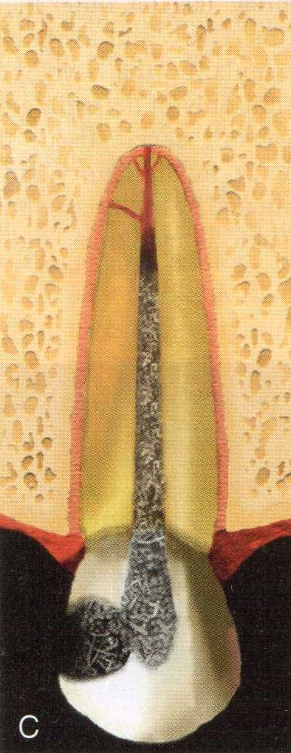
Bacteria continue to move towards the apical part of the canal until virtually the entire canal is necrotic and infected.
At this stage, involved bacteria can be regarded as the early root canal colonizers or pioneer species.

Slide 13
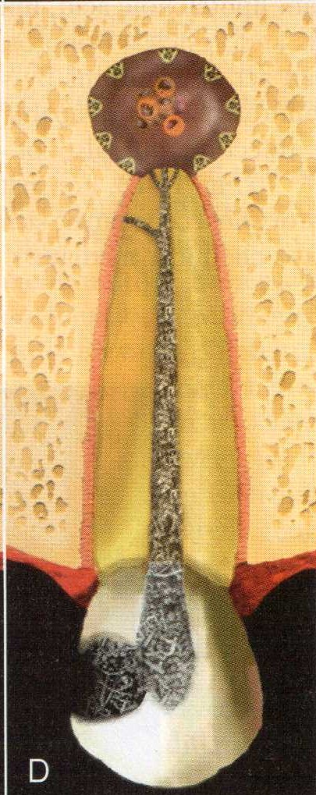
Bacteria colonizing the necrotic root canal induce damage to the periradicular tissues and give rise to inflammatory changes.
Periradicular inflammation can be observed even before the entire root canal is necrotic.
Therefore, the early colonizers play an important role in the initiation of the apical periodontitis disease process.

Slide 14
The environmental conditions in the root canal are modified by pioneer species and the disease process.
This leads to the establishment of bacterial groups different from the early colonizers.
Once the pulp is necrotic, a shift in microbiota is observed

Slide 15
Rearrangement in the proportions of the early colonizers and latecomers occurs.
As the environment changes, some early colonizers are expected to no longer participate in the consortium in advanced disease.

Slide 16
Colonization may appear an easy task for late colonizers as there is no significant opposition from host defense in necrotic root canal .
Environmental factors such as interaction with pioneer species, oxygen tension, nutrient availability will determine whether new species succeed in establishing themselves in the root canal

Slide 17
Bacteria exert their pathogenicity by wreaking havoc on the host tissues through direct and/or indirect mechanisms.
Bacterial virulence factors that cause direct tissue harm include those that damage host cells and/or the intracellular matrix of connective tissue.
These factors usually involve enzymes, exotoxins and mtabollic end products

Slide 18
Furthermore, bacterial structural components, including lipopolysaccharide, peptidoglycan, lipoteichoic acid, fimbriae, flagella, outer membrane proteins and vesicles, lipoproteins, DNA and exopolysaccharides can act as modulins, which stimulates host immune reactions that causes severe tissue destruction.

Slide 19
Bacterial components can stimulate inflammatory and non-inflammatory host cells to release chemical mediators such as cytokines and prostaglandins which are involved in bone resorption.
Host defence mechanisms against bacteria emanating from the root canal appear to be the most important factor involved in formation of purulent exudate associated with abscesses.

Slide 20
Formation of oxygen derived free radicals, such as superoxide and hydrogen peroxide, alongside the release of lysosomal enzymes by PMNs, gives rise to destruction of connective extracellular matrix, leading to pus formation.
Although bacterial products may certainly be involved in the pathogenesis of disease related to endodontic infections, bacterial indirect destructive effects seems to be more significant in the tissue damage.

Slide 21
A chronic disease is usually associated with low virulence of the bacterial consortium involved, but this represents a persistent source of aggression to the tissues.
Persistance in chronic infections is usually related to community organization in biofilms and the inaccessibility to host defences because of the anatomic location of the infection.

Slide 22
Thus, bacteria in the necrotic root canal cause chronic infection by forming biofilms on the canal walls and maintaining close contact with apical periodontal ligaments.
An acute infection in turn is usually caused by a high virulent bacterial consortium.
Acute infections are usually related to bacterial cells in a planktonic state, at high numbers, with tissue invasion ability, counteracted by a diminished host resistance.

Slide 23
Endodontic infection is a multifactorial disease that is resultant of the interplay of many host and bacterial factors.
This process requires an integrated and orchestrated interaction of the selected members of mixed endodontic micribiota and their respective virulence attributes.

Slide 24
PRIMARY INTRARADICULAR INFECTION

Slide 25
Primary infections are characterized by a mixed community, dominated by anaerobic bacteria.
The number of cells may vary from 10³ to 10⁸ per root canal.
Molecular studies have disclosed a mean of 10 to 20 species per infected root canal.
Canal of teeth with sinus tract exhibit a mean no. of 17 species

Slide 26
The size of apical periodontitis lesion has been shown to be proportional to the number of bacterial species and cells in the root canal.
Molecular studies has revealed ;
small lesion <5mm harbored about 12 species
5-10 mm → 16
>10mm → 20
Some larger lesions → 40

Slide 27
The most prevalent bacterial species detected in primary infections, including abscess cases, belong to diverse genera of gram –ve & +ve bacteria.
Gram –ve :- Fusobacterium, Dialister,
Porphyromonas, Prevotella, Tennerella,
Treponema, Campylobacter And Veillonella
Gram +ve:- Parvimonas, Filifactor, Pseudoramibacter,
Olsenella, Actinomyces, Peptostreptococcus,
Streptococcus, Propionibacterium And Eubacterium

Slide 28
About 40-55% of the endodontic microbiota in primary infections is composed of species still uncultivated.
Some uncultivated species can even be among the most prevalent bacteria in primary intraradicular infections, and other may be associated with pain.

Slide 29
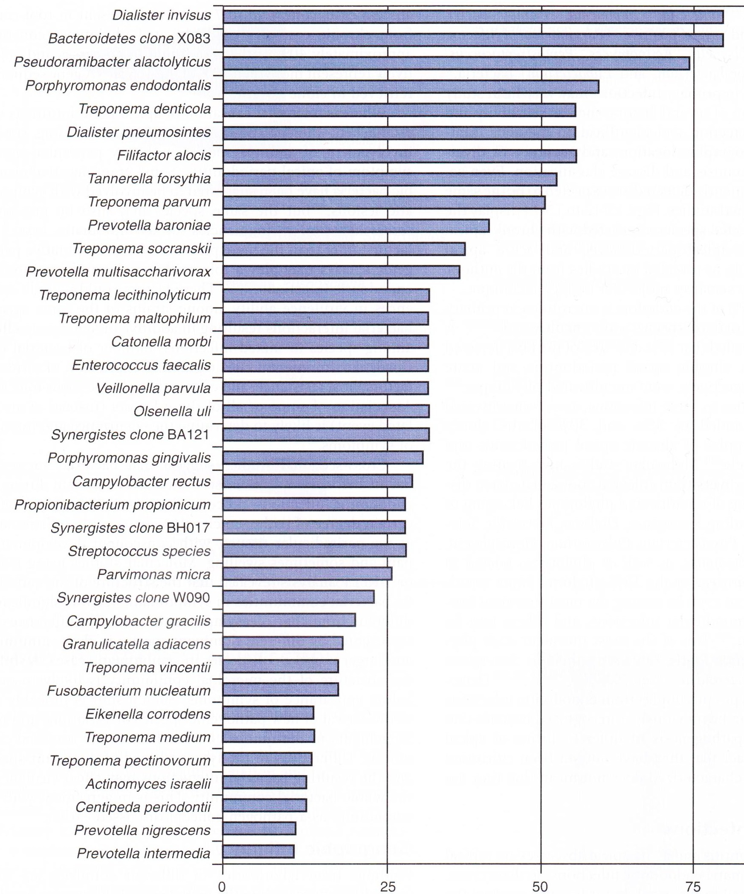
Chr.api.per

Slide 30
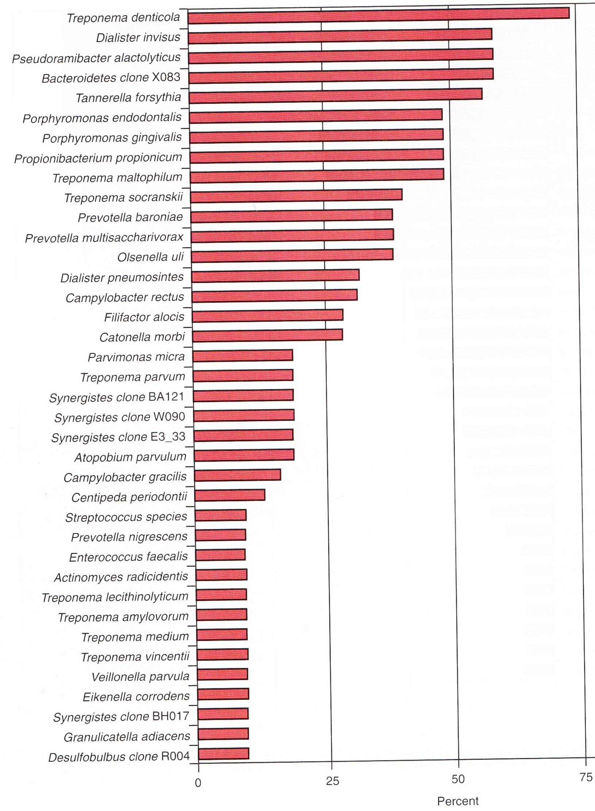
Acute.api.per

Slide 31
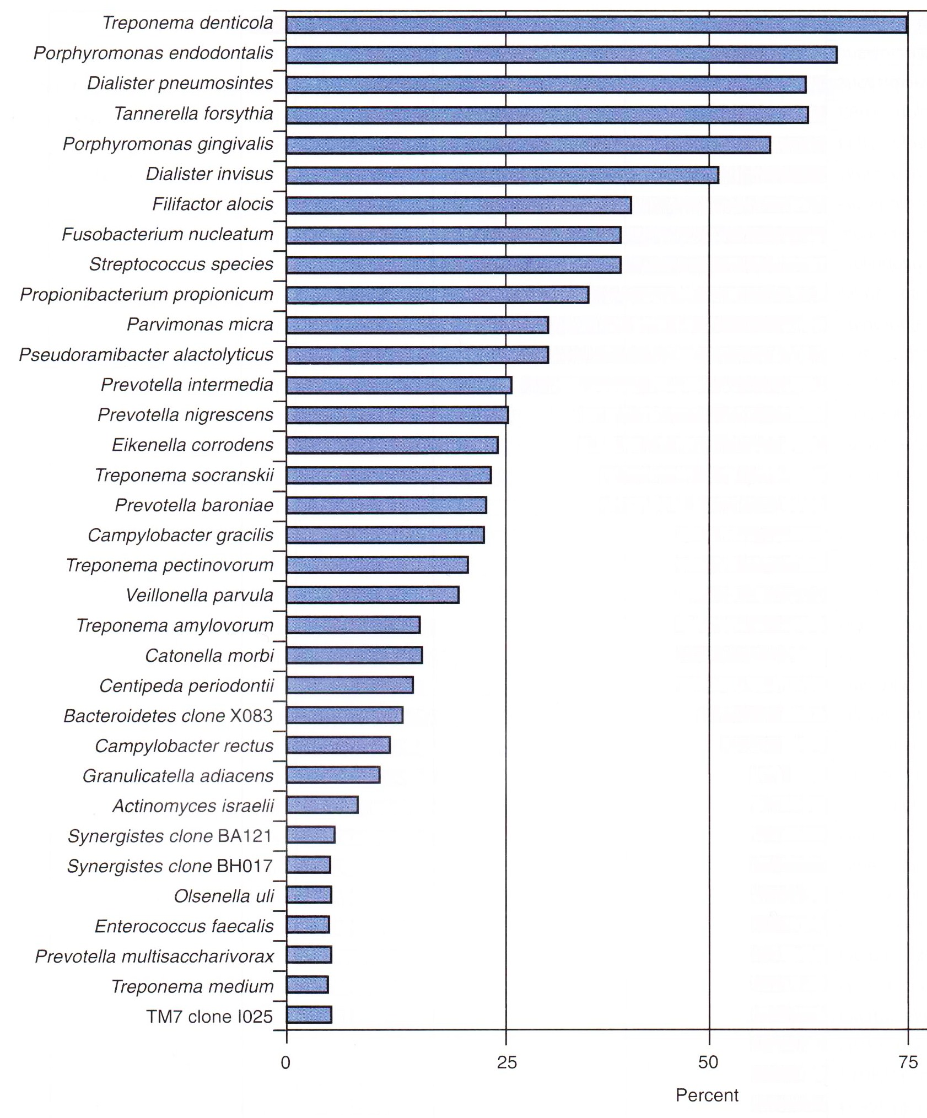
Acute.api.abs

Slide 32
Teaching Materials
Endodontic practices - Grossman
Pathways of pulp – Cohen
Textbook of Endodontics – Nisha Garg
Endodontics - Ingle

Slide 33
TAKE HOME MESSEGE/ FOR THE TOPIC COVERED (SUMMARY)
Infection of the root canal is not a random event.
The type and mix of the microbial flora develop in response to the surrounding environment. Microorganisms that establish in the untreated root canal experience an environment of nutritional diversity.
In contrast, well-filled root canal offers the microbial flora a small, dry, nutritionally limited space.
Thus, we should obtain a better understanding of the characteristics and properties of bacteria and their biofilms along with the environmental changes, to enhance success.

Slide 34
Question & Answer Session
What is pathogenicity & virulence factor
Intraradicular infections?

Slide 35
REFERENCES
Endodontic practices - Grossman
Pathways of pulp – Cohen
Textbook of Endodontics – Nisha Garg
Endodontics - Ingle

Slide 36
THANK YOU

